Slide 1
Website Advertising Rates
2015-2016
Button Ad
175 pixels x 100 pixels
$150.00/year
Tower Ad
175 pixels x variable height
Base price $150.00/year plus $1.00 per pixel
A 200 pixel Tower would be $150.00 + $100.00=$250.00
Appears in the “Sponsor’s Widget” in Left Column
Appears on Home Page, & all Story Pages & Site Pages for maximum “impressions”.
Tracks each time a viewer links through to the sponsor’s website.
If no website can provide a detailed document to link to.
Appears only on the “Home Page” between story headers.
Is linked to the Sponsor’s website but can not track the number of times it is clicked on.
Can provide the number of impressions per year.
Provides maximum visibility on page.
If no website can provide a detailed document to link to.

Slide 2
Location of button and tower ads in left column
Location of banner ad between two stories

Slide 3
Example of a
Button and Tower Ad as it appears on a Story Page

Slide 4
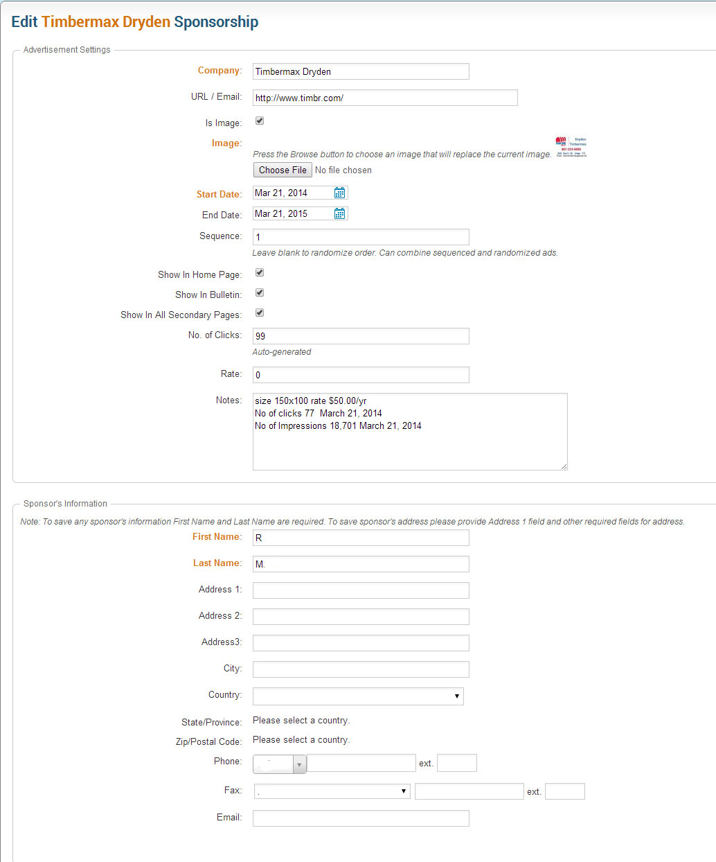
Example of Advertising Management
Sequence can be changed
End date automatically removes ad from sponsor’s widget
Example of Sponsor’s Data Record

Slide 5
Advertising Cost Factors
The standard ad tools are Cost Per Click (CPC) and Cost Per Impression (CPI)
CPC tracks the number of times a visitor clicks on your ad and visits your website. In some systems you pay a fee for each click. For 2015 the average click costs between $1.00 and $2.00 USD depending on a variety of factors.
CPI is like a newspaper ad where you pay a cost based on the circulation of the newspaper assuming 1 view of the ad per customer. A web view is called an “impression”. On average each District 5550 ad is seen 1,250 times per month or 15,000 impressions per year. CPI is also called CPM or Cost per thousand (M). The cost of one impression is therefore 1 cent per impression at $150.00 for a button ad.
For example during 2014-15 the District 5550 site had 4 ads. The average number of Clicks for each ad was 277 so the minimum an advertiser should pay, at $1.00/CPC, is $277.00 .
Hence when one combines the CPC and the CPI, a flat fee of $150.00/year is good advertising value.
In addition District 5550 does not charge a set-up fee, nor do they charge a design fee.

